Slide 1
ShreySandeepJain_Assignment8_tableaufile
File created on: 22-Sep-24 2:34:27 AM

Slide 2
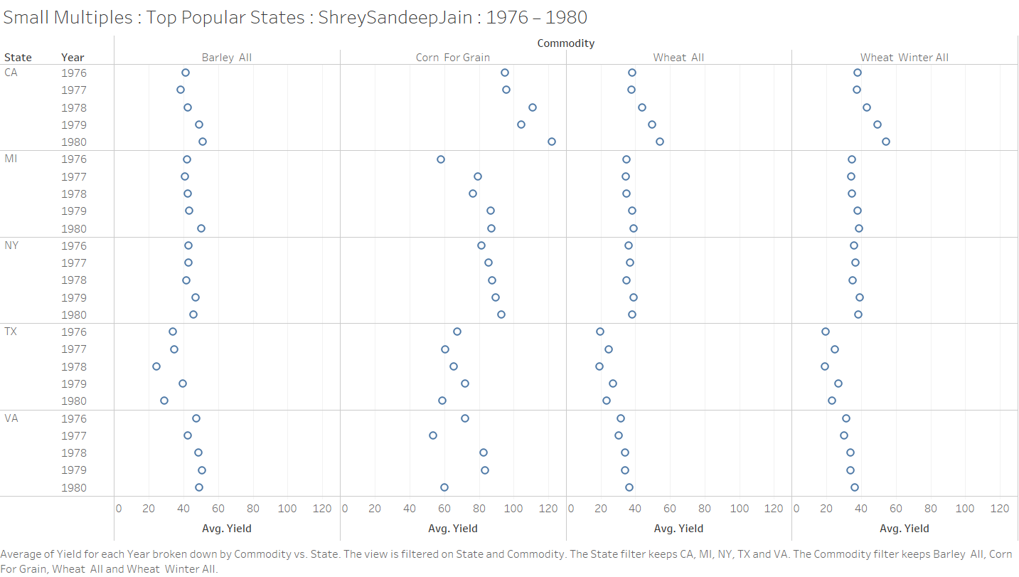

Slide 3
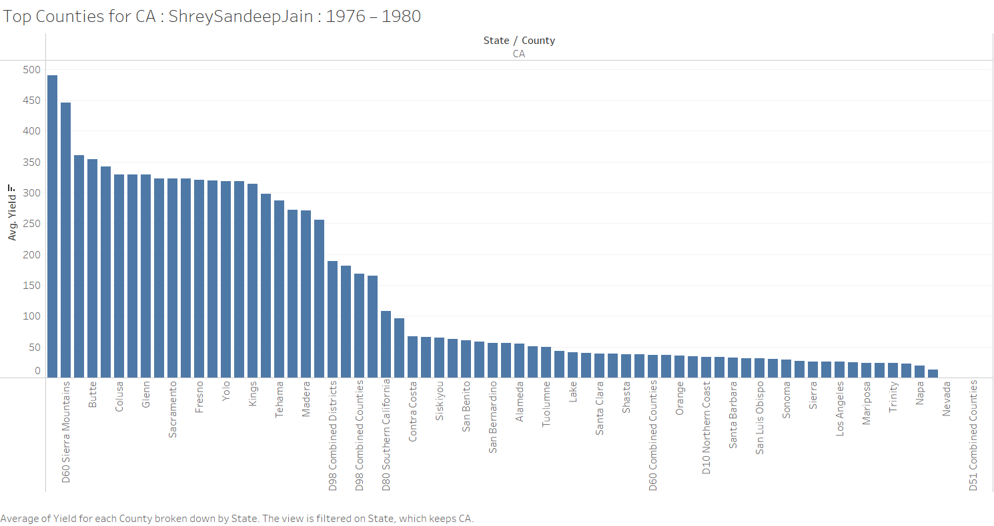

Slide 4
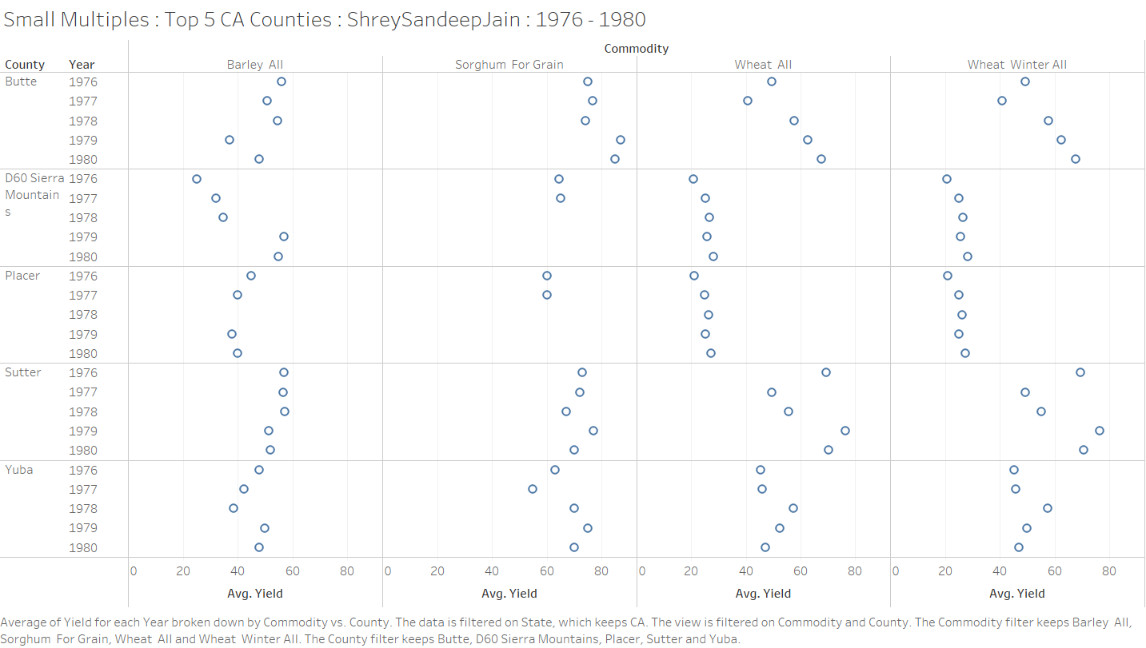

Slide 5
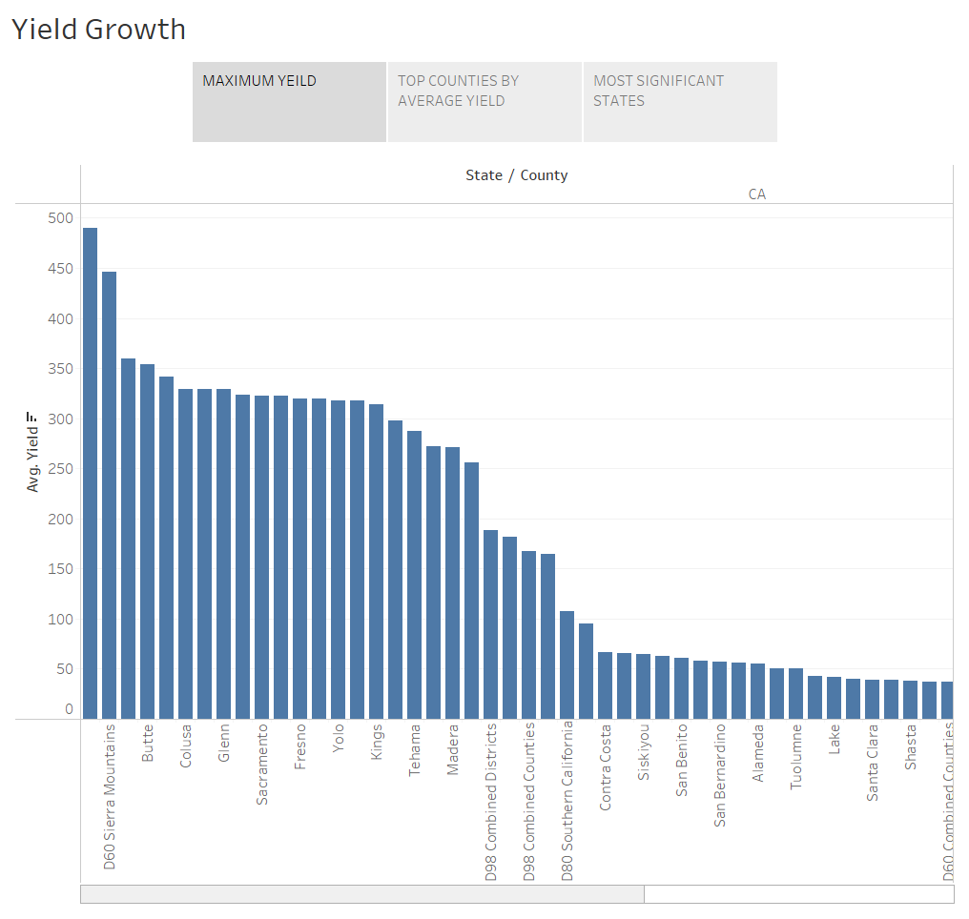

Slide 6
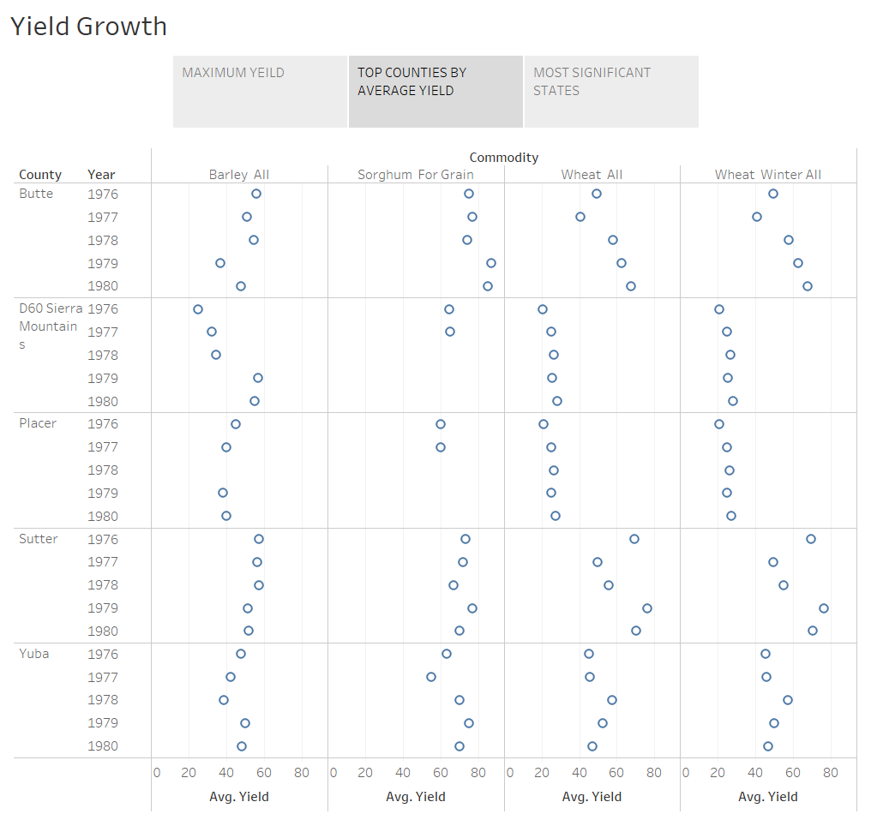

Slide 7
